Slide 1
Software Testing Strategies
CSE3209: Software Engineering

Slide 2
Discussion Topics
Program Testing
Aim of Testing
Verification vs Validation
Design of Test Cases
Functional Testing Vs. Structural Testing
Black Box Testing
White Box Testing

Slide 3

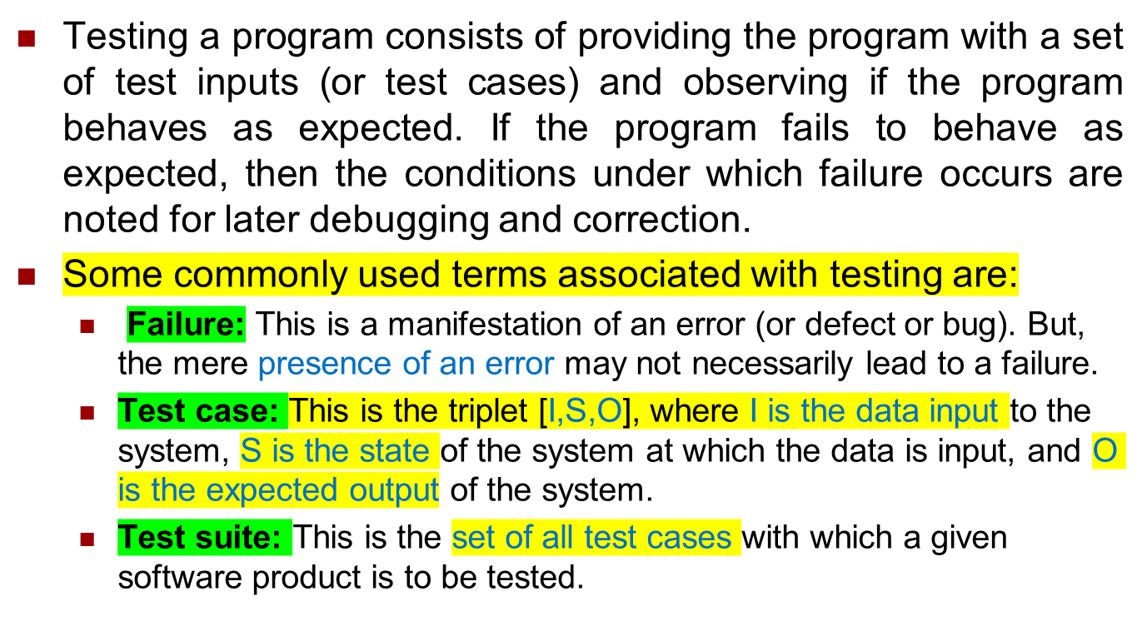

Program Testing

Slide 4

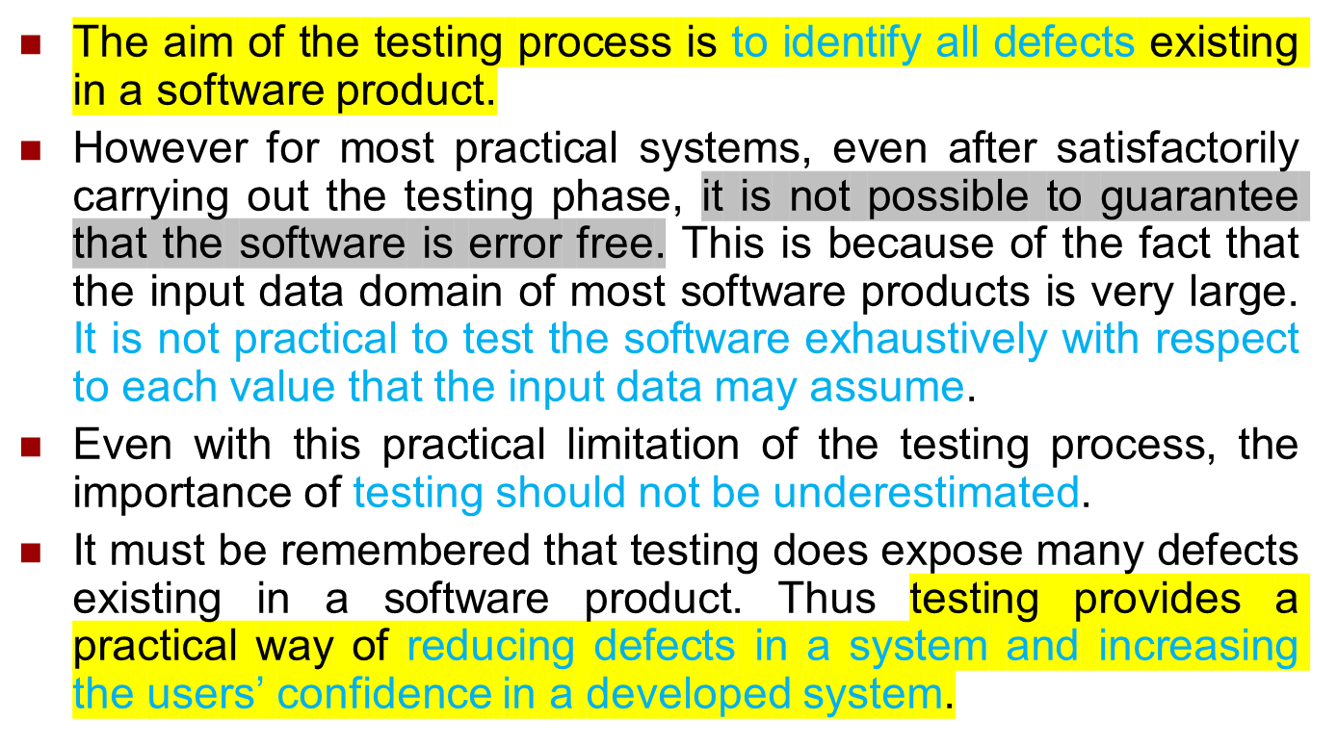
Aim of Testing

Slide 5


Verification is the process of determining whether the output of one phase of software development conforms to that of its previous phase.
  Verification is concerned with phase containment of errors.
Validation is the process of determining whether a fully developed system conforms to its requirements specification.
  Aim of validation is that the final product be error free.

Slide 6
Design of Test Cases
Exhaustive testing of almost any non-trivial system is impractical due to the fact that the domain of input data values to most practical software systems is either extremely large or infinite.
Therefore, we must design an optional test suite that is of reasonable size and can uncover as many errors existing in the system as possible.
But larger test suite does not always detects more error. For example lets consider the following code:
  if (x>y)
  max = x;
  else
  max = x;

Slide 7
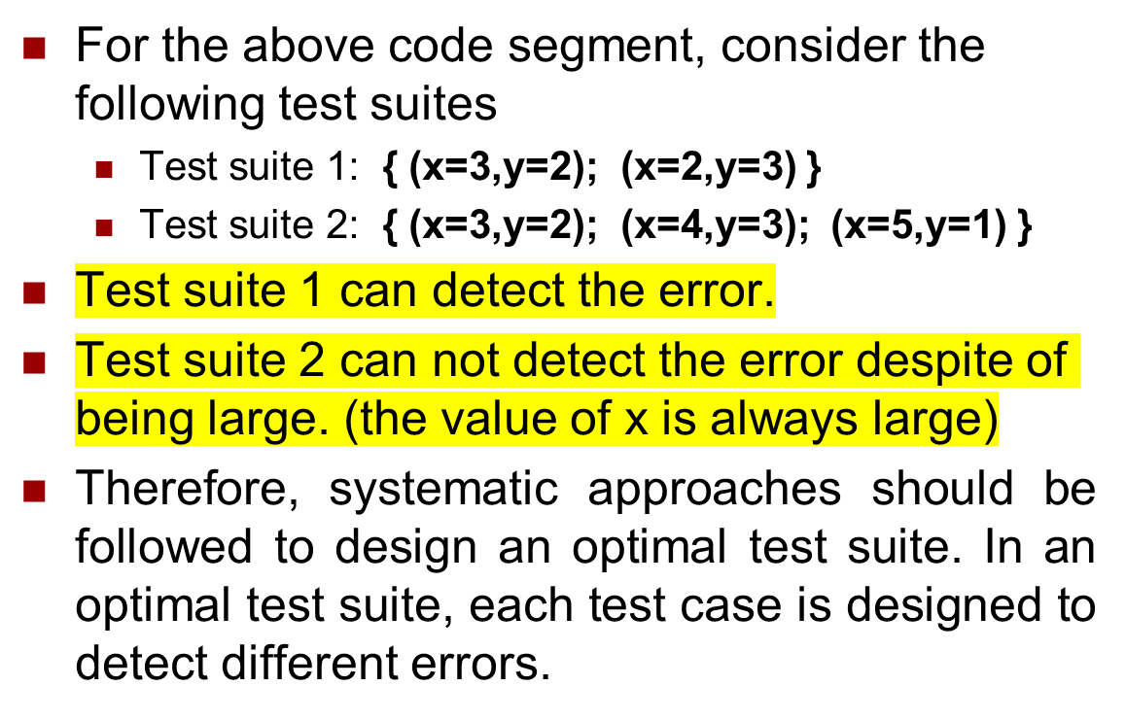
Design of Test Cases(Cont..)

Slide 8
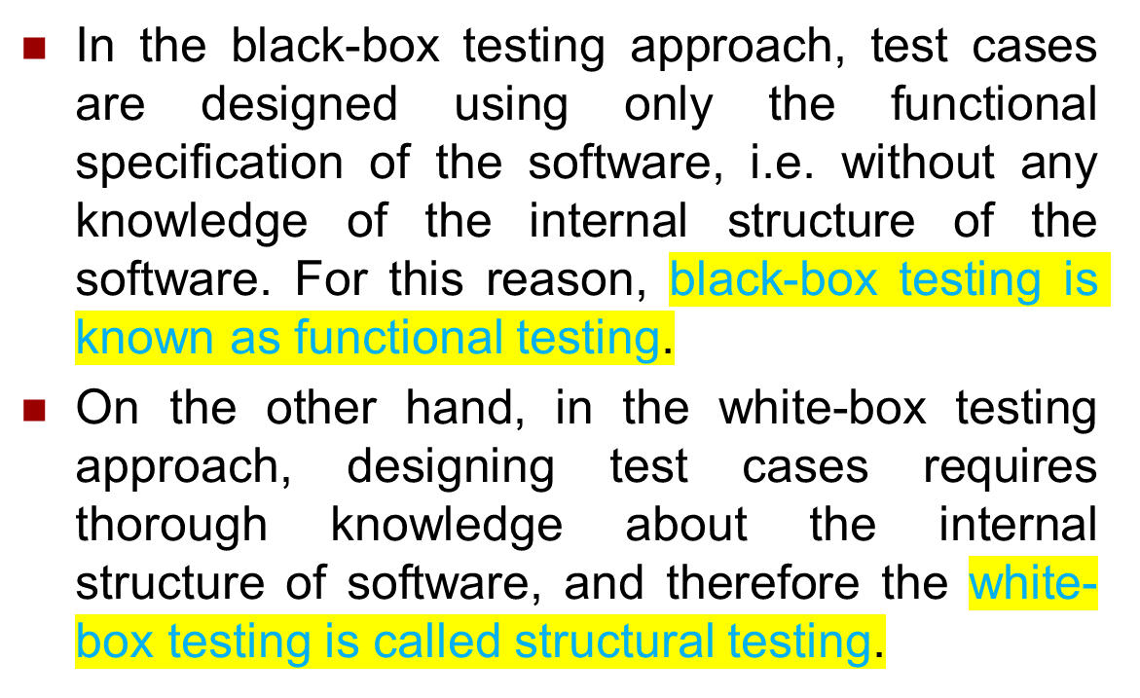
Functional Testing Vs. Structural Testing

Slide 9

Unit testing is performed after a module is fully coded and has passed code review, to verify that the individual unit works correctly.
Is also known as module testing.
Unit testing is undertaken after a module has been coded and successfully reviewed. Unit testing (or module testing) is the testing of different units (or modules) of a system in isolation.
In order to test a single module, a complete environment is needed to provide all that is necessary for execution of the module. That is, besides the module under test itself, the following steps are needed in order to be able to test the module:
  The procedures belonging to other modules that the module under test calls.
  Nonlocal data structures that the module accesses.
  A procedure to call the functions of the module under test with appropriate parameters.
To test a module, some extra steps are needed besides the module itself.
External (nonlocal) data used by the module.

Slide 10






module
to be
tested
interface
local data structures
boundary conditions
independent paths
error handling paths
test cases

Slide 11

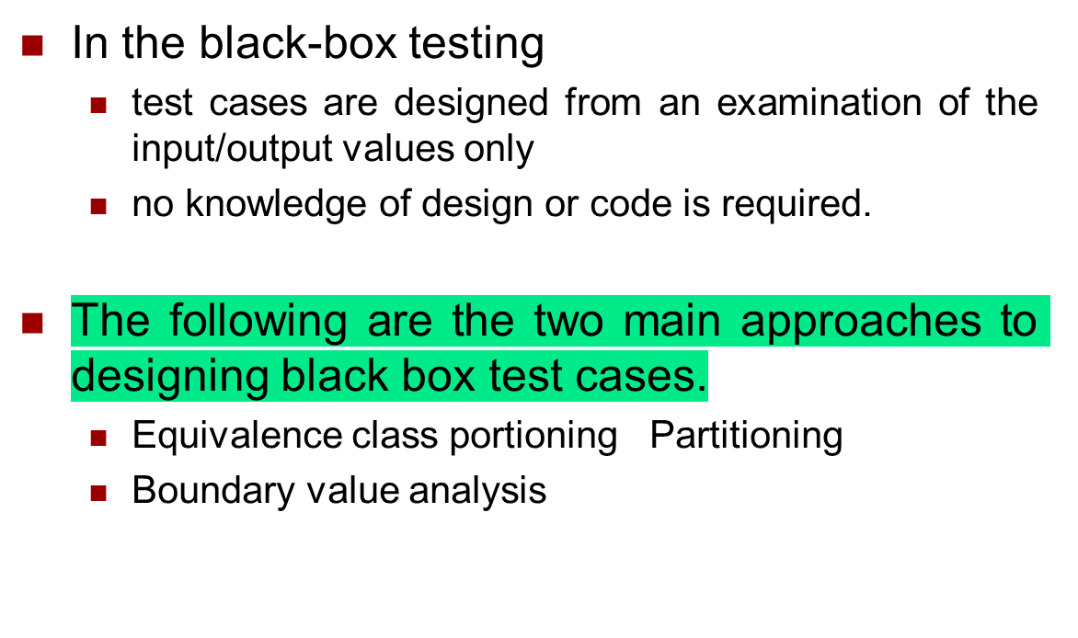


Slide 12
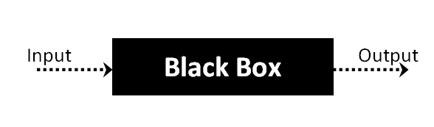
Black Box Testing
In Black Box Testing we just focus on inputs and output of the software system without bothering about internal knowledge of the software program.

Slide 13

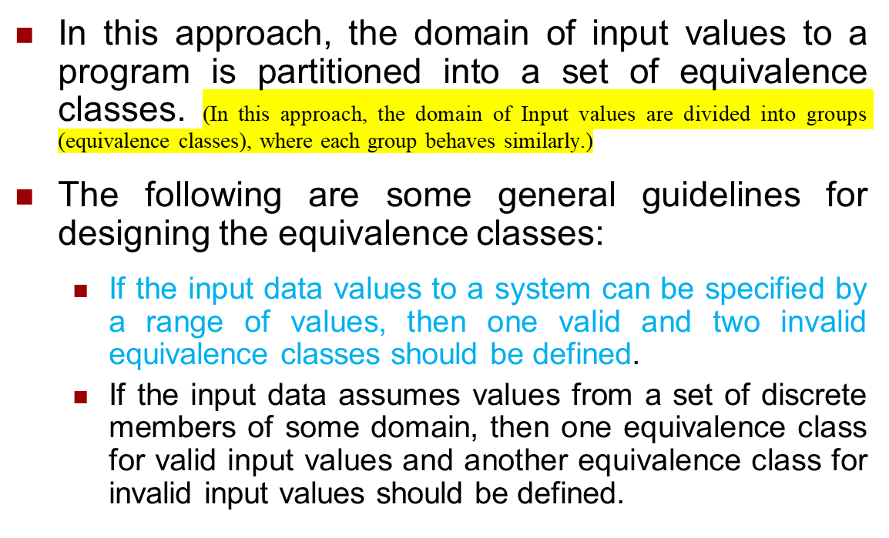
#.For inputs with a range of values:
Make 1 valid class (values that are allowed).
Make 2 invalid classes (values below the range and values above the range).
#.For inputs with specific discrete values:
Make 1 valid class (values that are allowed).
Make 1 invalid class (values that are not allowed)

Slide 14
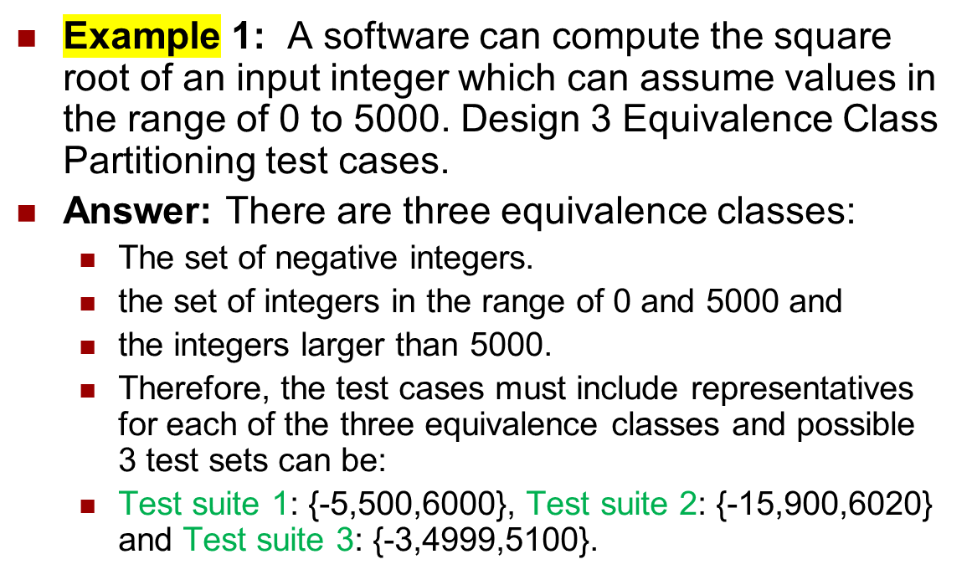

Equivalence Class Partitioning

Slide 15
Solution From Ai:
Equivalence Classes:
1. Negative integers (<0)
2. Integers in the range 0–5000
3. Integers greater than 5000
Test Cases:
Test set 1: {-5, 500, 6000}
Test set 2: {-15, 900, 6020}
Test set 3: {-3, 4999, 5100}

Slide 16
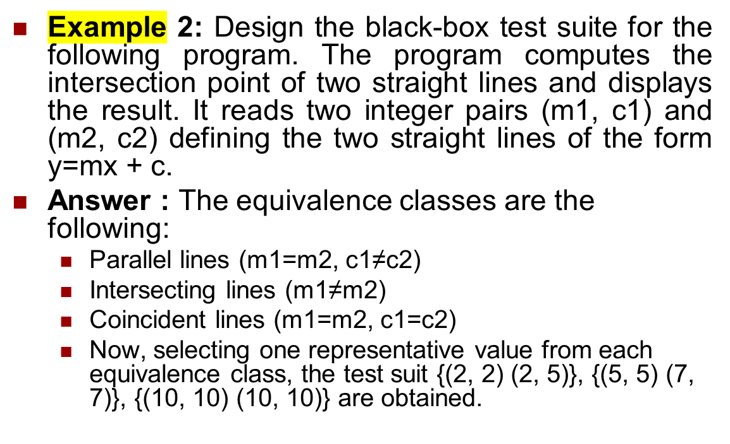
Equivalence Class Partitioning

Slide 17
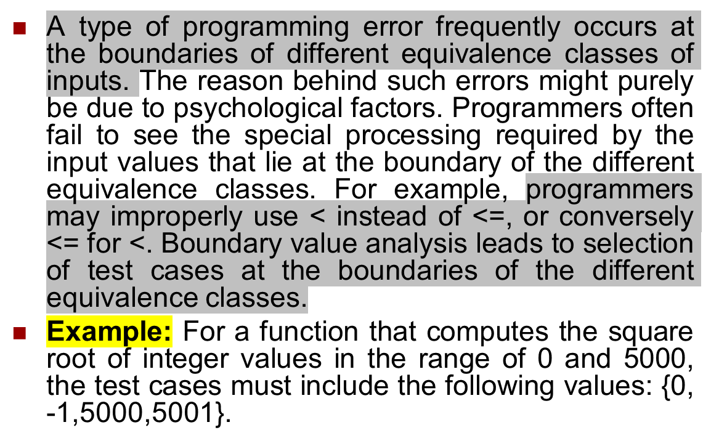
Boundary Value Analysis

Slide 18

Boundary Value Analysis from Ai
What it is: A type of testing that focuses on values at the boundaries of equivalence classes.
Why needed: Many errors happen at boundaries because programmers often:
Forget special cases at the edge
Use `<` instead of `<=`, or vice versa
Example:
If valid input range = 0–5000:
Boundaries are 0 and 5000
Test cases: 0, 1, 4999, 5000, 5001
Key point: By testing boundary values, we catch errors that usually happen only at the edges, which are easy to miss otherwise.

Slide 19

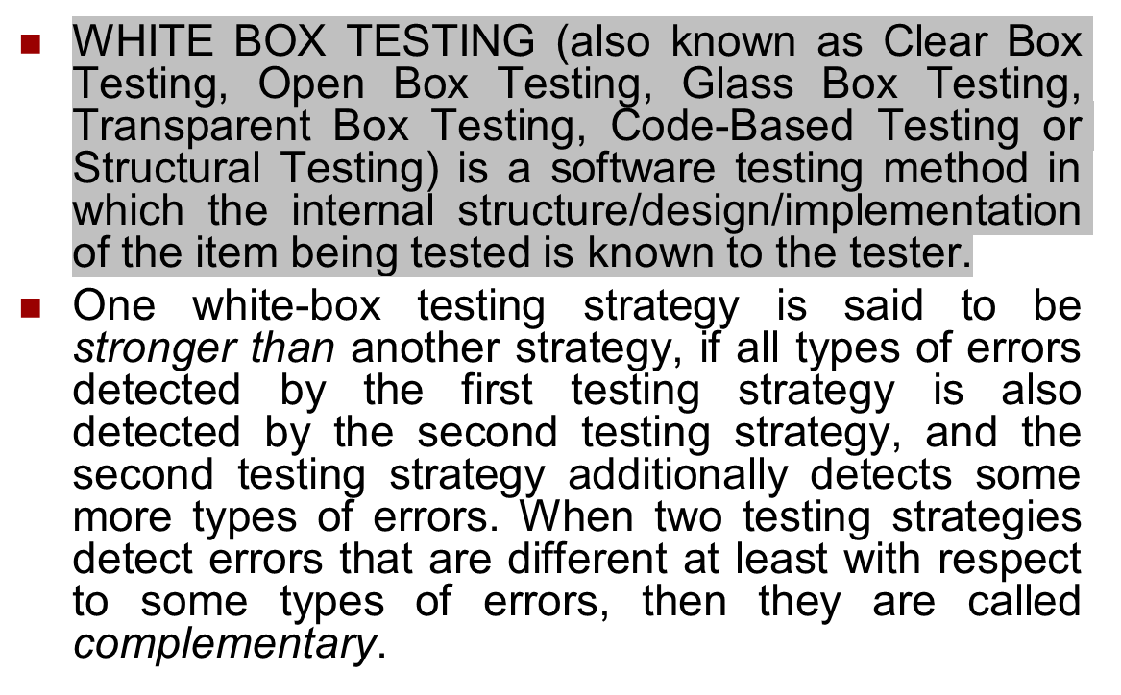
Stronger Strategy:
A white-box testing strategy A is stronger than B if:
All errors detected by B are also detected by A, and
A detects some additional errors that B cannot.
Complementary Strategies:
Two strategies are complementary if they detect different types of errors that the other may miss.

Slide 20

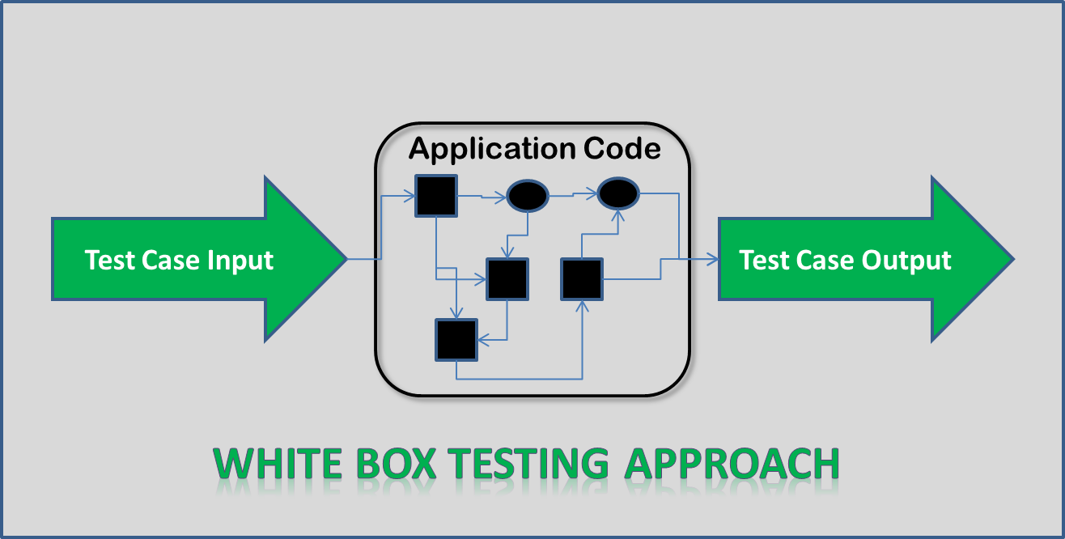
White-box testing (also known as clear box testing, glass box testing, transparent box testing, and structural testing) is a method of testing software that tests internal structures or workings of an application, as opposed to its functionality

Slide 21



WHITE-BOX TESTING
Example: Consider the Euclid’s GCD computation algorithm:
int compute_gcd(x, y) {
int x, y;
while (x! = y) {
if (x>y)
x= x – y;
else
y= y – x;
}
return x;
}
By choosing the test set {(x=3, y=3), (x=4, y=3), (x=3, y=4)}, we can exercise the program such that all statements are executed at least once.
সবগুলো পার্টে at least একবার হলেও ডুকবে এরকম ইনপুট নিবো।

Slide 22
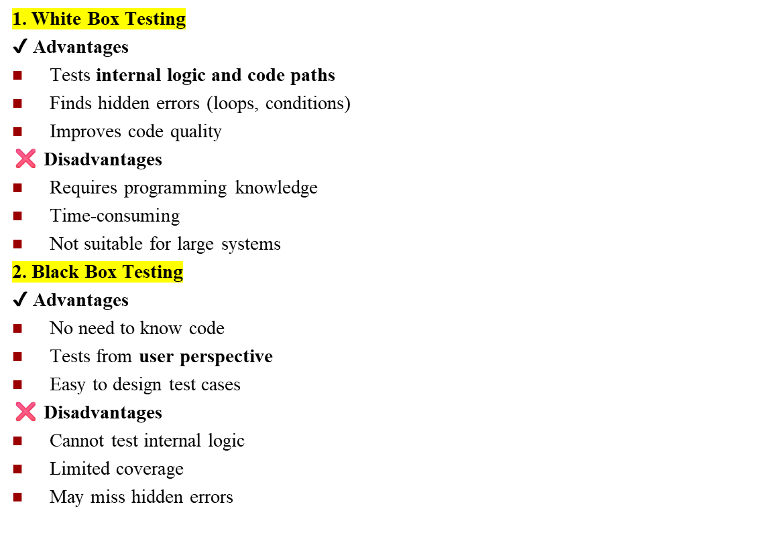
From Ai

Slide 23
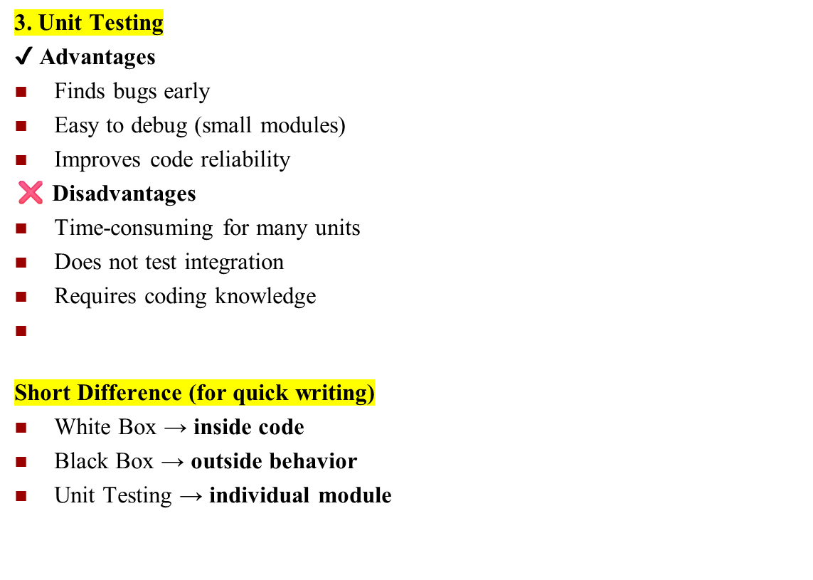
From Ai

Slide 24
References
Software Maintenance Models
https://www.professionalqa.com/software-maintenance-models
Chapter 9 software maintenance
https://www.slideshare.net/abhinavtheneo/chapter-9-software-maintenance

